Slide 1
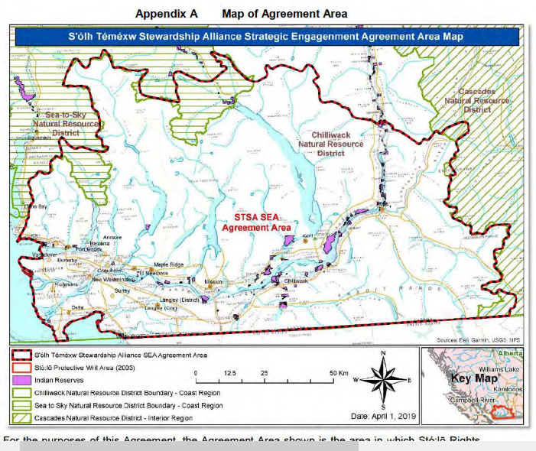
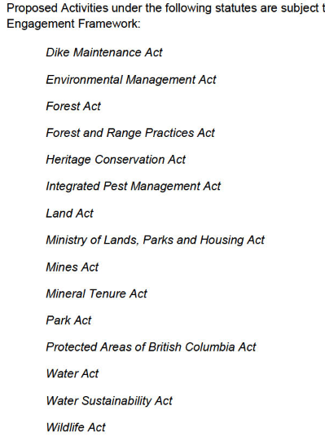
FOI TOL communications with WLRS
https://west-creek-awareness.ca/wp-content/uploads/2025/01/township-of-langley-foi-24-174.pdf

Slide 2
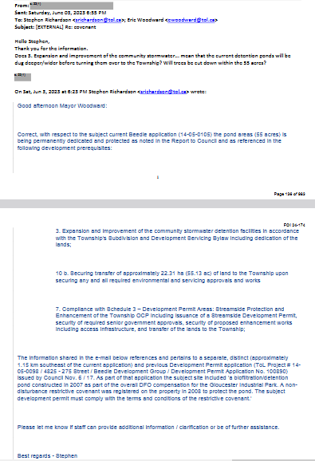

Slide 3
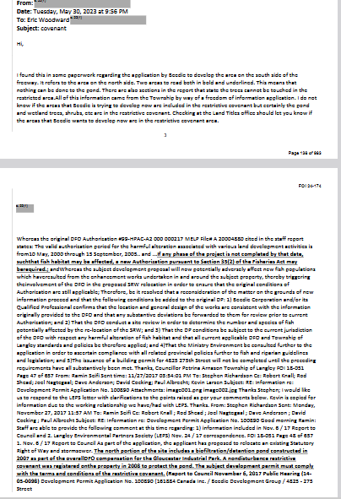
Two areas to read both in bold and underlined. This means that nothing can be done to the pond. There are also sections in the report that state the trees cannot be touched in the restricted area. All of this information came from the Town ship by way of a freedom of information application. I do not know if the areas that Beedie is trying to develop now are included in the restrictive covenant but certainly the pond and wetland trees, shrubs, etc are in the restrictive covenant. Checking at the Land Titles office should let you know if the areas that Beedie wants to develop now are in the restrictive covenant area.
Pages
138 -
139
The north portion of the site includes a biofiltration/detention pond constructed in 2007 as part of the overall DFO compensation for the Gloucester Industrial Park. A non disturbance restrictive covenant was registered on the property in 2008 to protect the pond. The subject development permit must comply with the terms and conditions of the restrictive covenant. (Report to Council November 6, 2017 Public Hearing (14‐ 05‐0098) Development Permit Application No. 100890 (161884 Canada Inc. / Beedie Development Group / 4825 ‐ 275
Street
https://west-creek-awareness.ca/wp-content/uploads/2025/01/township-of-langley-foi-24-174.pdf

Slide 4
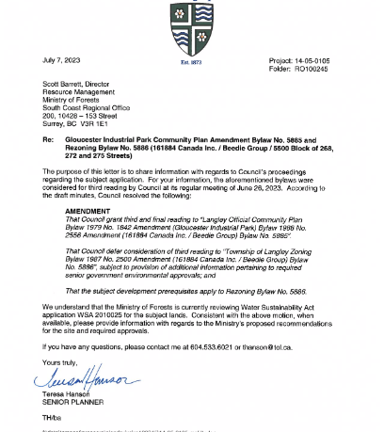
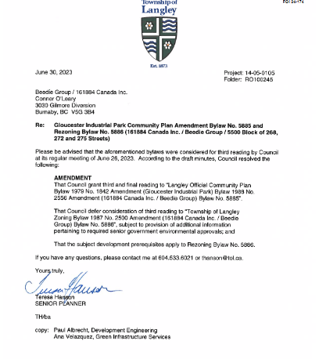

Slide 5
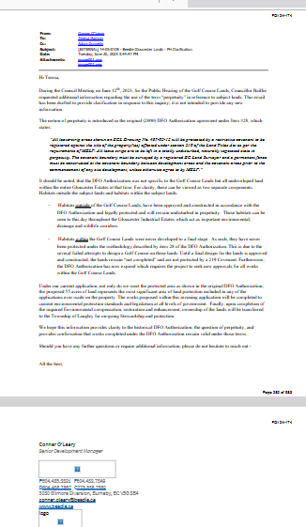

Page
280
The notion of perpetuity is introduced in the original (2000) DFO Authorization agreement under Item #28, which
states:
“All leave-strip areas shown on ECL Drawing No. 467-02-12 will be protected by a restrictive covenant to be registered against the title of the property(ies) affected under section 219 of the Land Titles Act as per the requirements of MELP. All leave strips are to be left in a totally undisturbed, naturally vegetated state in perpetuity. The covenant boundary must be surveyed by a registered BC Land Surveyor and a permanent fence must be constructed at the covenant boundary between development areas and the covenant areas prior to the commencement of any site development, unless otherwise agree to by MELP.”
It should be noted, that the DFO Authorization was not specific to the Golf Course Lands but all undeveloped land within the entire Gloucester Estates at that time. For clarity, these can be viewed as two separate components. Habitats outside the subject lands and habitats within the subject lands.
Habitats outside of the Golf Course Lands, have been approved and constructed in accordance with the DFO Authorization and legally protected and will remain undisturbed in perpetuity. These habitats can be seen to this day throughout the Gloucester Industrial Estates which act as important environmental, drainage and wildlife corridors.
Habitats within the Golf Course Lands were never developed to a final stage. As such, they have never been protected under the methodology described by item 28 of the DFO Authorization.This is due to the several failed attempts to design a Golf Course on these lands. Until a final design for the lands is approved and constructed, the lands remain “not completed” and are not protected by a 219 Covenant. Furthermore, the DFO Authorization has now expired which requires the project to seek new approvals for all works within the Golf Course Lands.

Slide 6
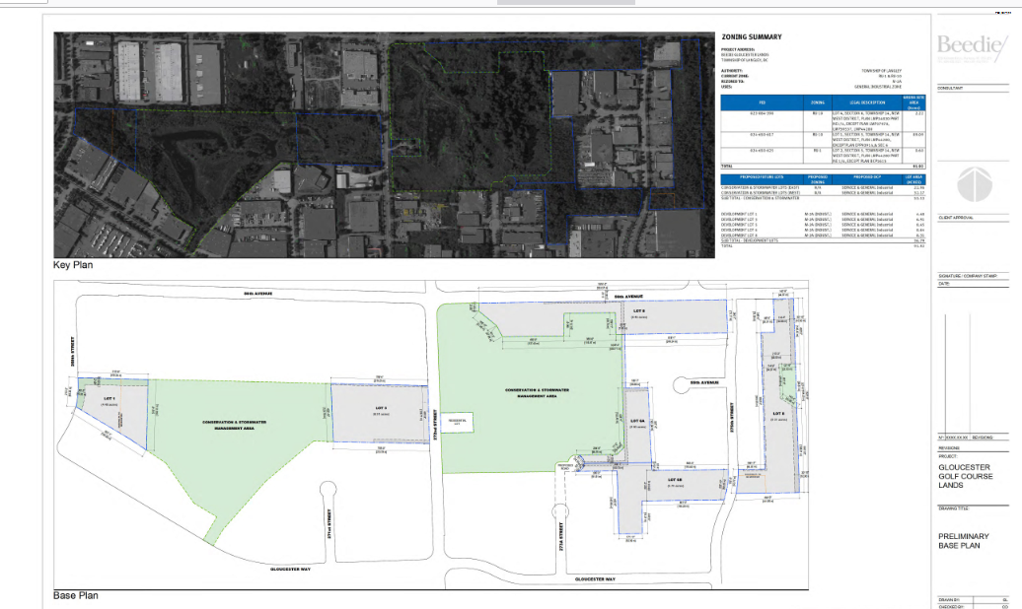
Page 347

Slide 7
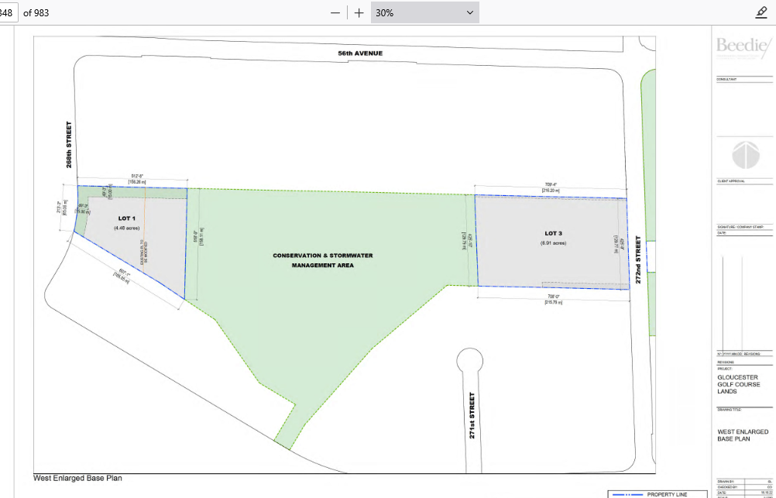
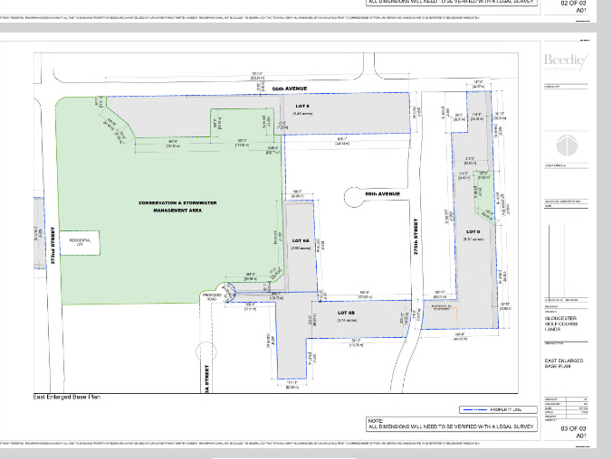

Slide 8
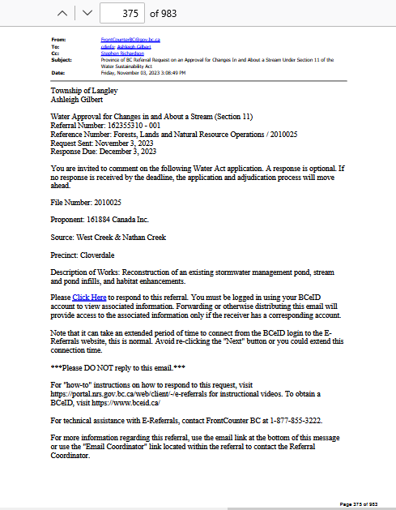
File Number: 2010025
Proponent: 161884 Canada Inc.
Source: West Creek & Nathan Creek
Shawn Fitzsimons
FrontCounter BC
Water Authorizations Specialist - Stream Management
(778) 572-2232
shawn.fitzsimons@gov.bc.ca

Slide 9
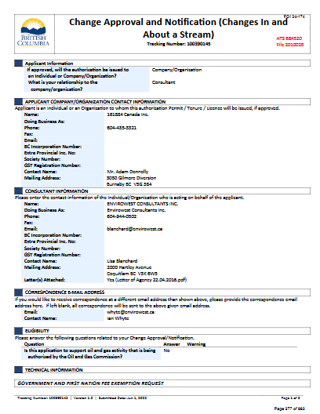
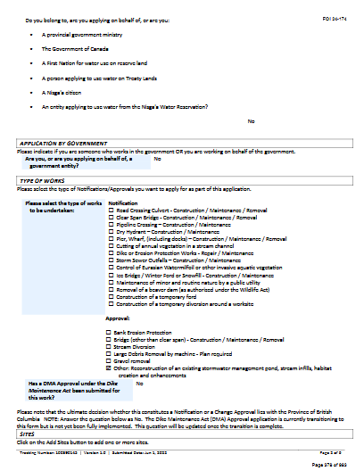
Pages
377
378
https://west-creek-awareness.ca/wp-content/uploads/2025/01/township-of-langley-foi-24-174.pdf

Slide 10
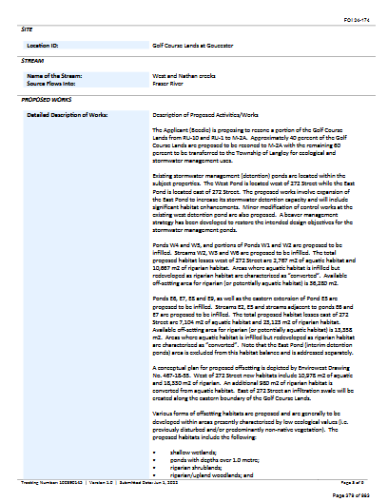
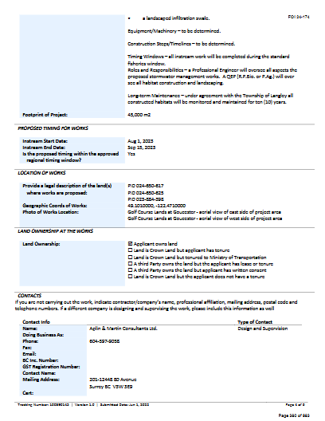

Slide 11
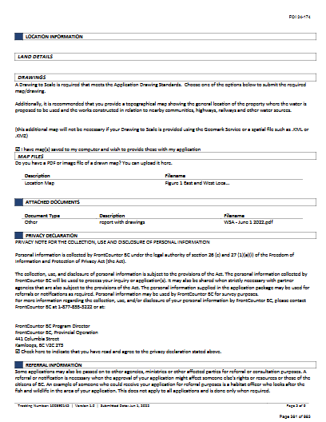
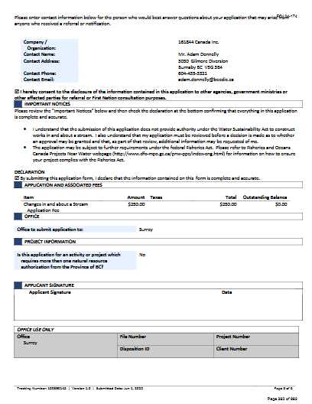

Slide 12
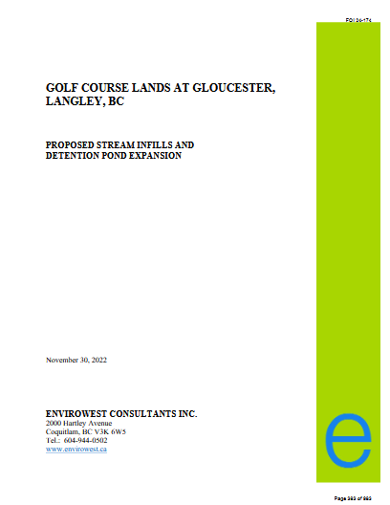
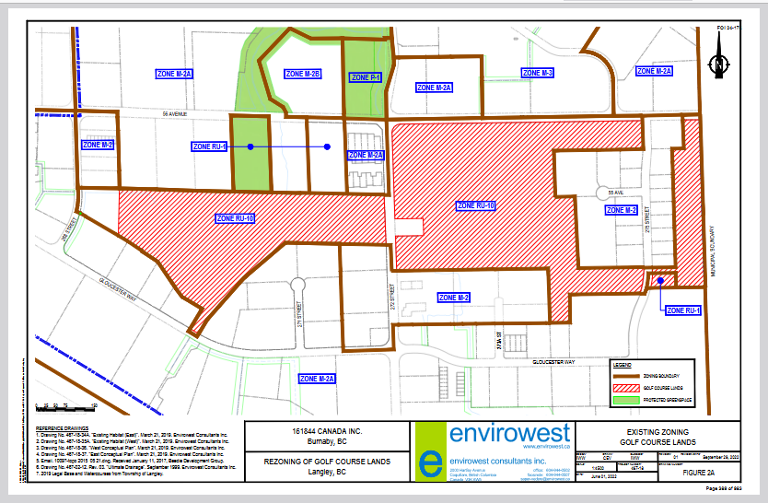
Page 389

Slide 13
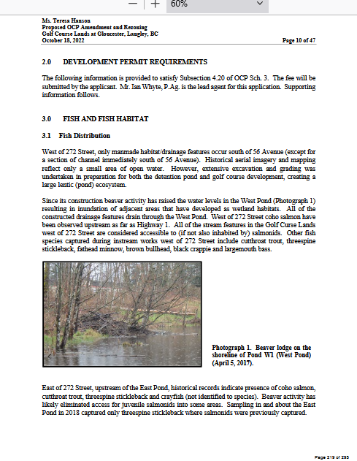
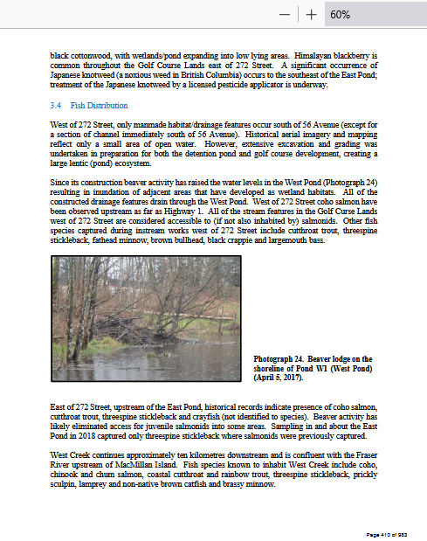
Oct 2022 Nov 2023
East of 272 Street, upstream of the East Pond, historical records indicate presence of coho salmon,
cutthroat trout, threespine stickleback and crayfish (not identified to species). Beaver activity has
likely eliminated access for juvenile salmonids into some areas. Sampling in and about the East
Pond in 2018 captured only threespine stickleback where salmonids were previously captured
May 2025
Proof of Life. Video Evidence of Coho Successfully Spawning in West Creek Headwaters
East of 272 St
https://west-creek-awareness.ca/wp-content/uploads/2025/01/township-of-langley-foi-24-174.pdf
https://west-creek-awareness.ca/wp-content/uploads/2025/01/township-of-langley-foi-24-174.pdf

Slide 14
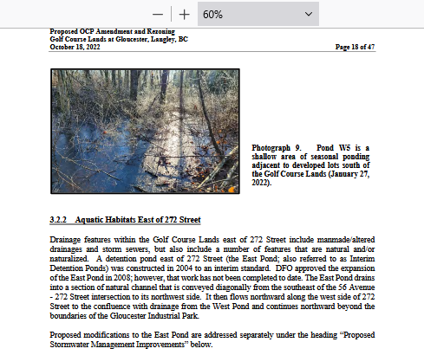
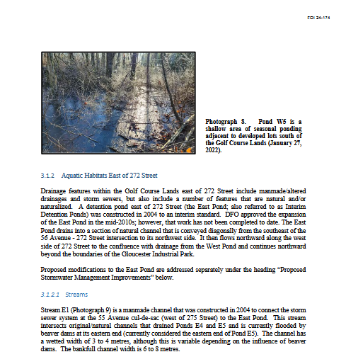
Oct 2022 Nov 2023
Page 19 Page 402
https://west-creek-awareness.ca/wp-content/uploads/2023/05/township-of-langley-foi-23-026-pgs.-209-256.pdf\
https://west-creek-awareness.ca/wp-content/uploads/2025/01/township-of-langley-foi-24-174.pdf
Aquatic Habitats East of 272 Street
Drainage features within the Golf Course Lands east of 272 Street include manmade/altered drainages and storm sewers, but also include a number of features that are natural and/or naturalized. A detention pond east of 272 Street (the East Pond; also referred to as Interim Detention Ponds) was constructed in 2004 to an interim standard. DFO approved the expansion of the East Pond in 2008; however, that work has not been completed to date. The East Pond drains into a section of natural channel that is conveyed diagonally from the southeast of the 56 Avenue- 272 Street intersection to its northwest side. It then flows northward along the west side of 272 Street to the confluence with drainage from the West Pond and continues northward beyond the boundaries of the Gloucester Industrial Park.
Aquatic Habitats East of 272 Street
Drainage features within the Golf Course Lands east of 272 Street include manmade/ altered drainages and storm sewers, but also include a number of features that are natural and/or naturalized. A detention pond east of 272 Street (the East Pond; also referred to as Interim Detention Ponds) was constructed in 2004 to an interim standard. DFO approved the expansion of the East Pond in the mid-2010s; however, that work has not been completed to date. The East Pond drains into a section of natural channel that is conveyed diagonally from the southeast of the 56 Avenue - 272 Street intersection to its northwest side. It then flows northward along the west side of 272 Street to the confluence with drainage from the West Pond and continues northward beyond the boundaries of the Gloucester Industrial Park.

Slide 15
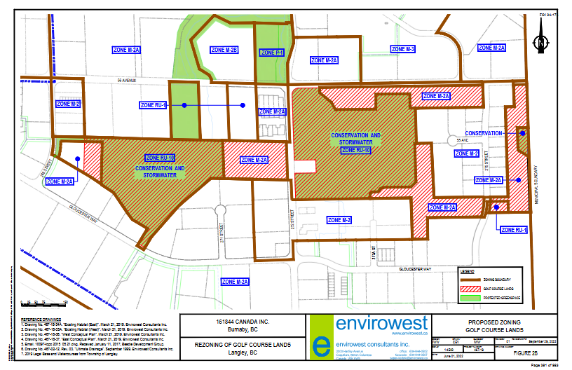
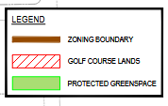

1.4 Development Objective
Beedie is proposing to rezone a portion of the Golf Course Lands from RU-10 and RU-1 to M-2A.
The Golf Course Lands are comprised of one large lot (PID 024-650-617) of 36.05 ha (89.09 acres)
and a smaller lot (PID 024-650625) of 0.24 ha (0.60 acres) located east of 275 Street. The
development application also includes one lot outside of the Golf Course Lands. The lot east of
268 Street (PID 023-884-398) is currently zoned RU-10 and will also be rezoned to M-2A.
Approximately 40 percent of the Golf Course Lands are proposed to be rezoned to M-2A with the
remaining 60 percent to be transferred to the Township of Langley for ecological and stormwater
management uses. Proposed zoning is shown n Figure 2B.
The Golf Course Lands are surrounded by developed industrial properties with the exception of
several yet-to-be developed properties, and ALR land in the adjacent City of Abbotsford. The
Golf Course Lands occur to the south of 56 Avenue, on both the east and west sides of 272 Street.
Figure 3 illustrates the boundaries of the Golf Course Lands.

Slide 16
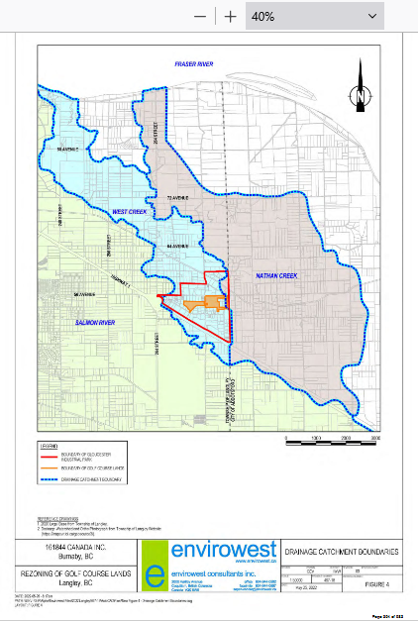
Page
394
2.1 Watershed Context
The Golf Course Lands are located primarily within the headwaters of West Creek, with a small eastern portion situated within the headwaters of Nathan Creek. These streams drain generally northward to the Fraser River and are both identified as sensitive streams under the Water
Sustainability Regulation.
The location of the Gloucester Industrial Park (and Golf Course Lands) relative to watershed
boundaries is depicted in Figure 4. Envirowest Drawing No. 467-18-41 (Attachment A) defines
the catchment boundaries within the industrial park.

Slide 17
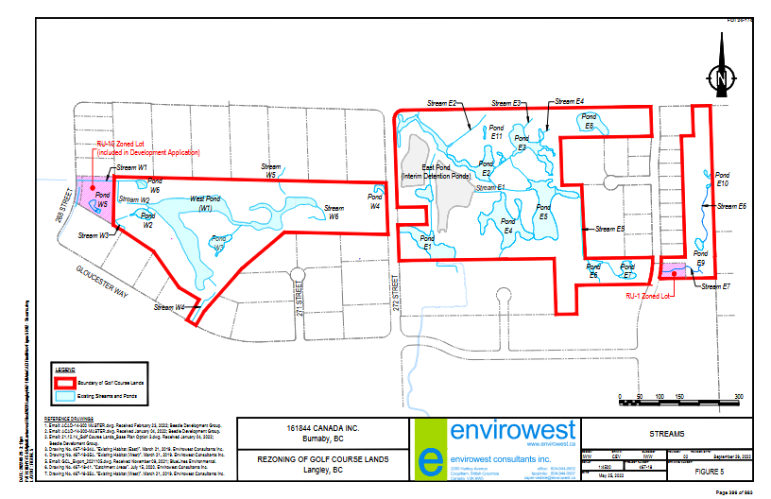
Ponds W4 and W5, and portions of Ponds W1 and W2 are proposed to be infilled. Streams W2, W3 and W6 are proposed to be infilled. The total proposed habitat losses west of 272 Street are 2,767 m2 of aquatic habitat and 10,667 m2 of riparian habitat. Areas where aquatic habitat is infilled but redeveloped as riparian habitat are characterized as “converted”. Available off-setting area for riparian (or potentially aquatic habitat) is 36,280 m2.
Ponds E6, E7, E8 and E9, as well as the eastern extension of Pond E5 are proposed to be infilled. Streams E2, E5 and streams adjacent to ponds E6 and E7 are proposed to be infilled. The total proposed habitat losses east of 272 Street are 7,104 m2 of aquatic habitat and 23,123 m2 of riparian habitat. Available off-setting area for riparian (or potentially aquatic habitat) is 13,358 m2. Areas where aquatic habitat is infilled but redeveloped as riparian habitat are characterized as “converted”. Note that the East Pond (interim detention ponds) area is excluded from this habitat balance and is addressed separately

Slide 18
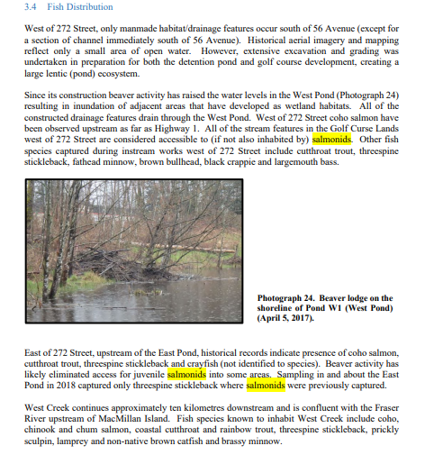
East of 272 Street, upstream of the East Pond, historical records indicate presence of coho salmon, cutthroat trout, threespine stickleback and crayfish (not identified to species). Beaver activity has likely eliminated access for juvenile salmonids into some areas. Sampling in and about the East Pond in 2018 captured only threespine stickleback where salmonids were previously captured

Slide 19
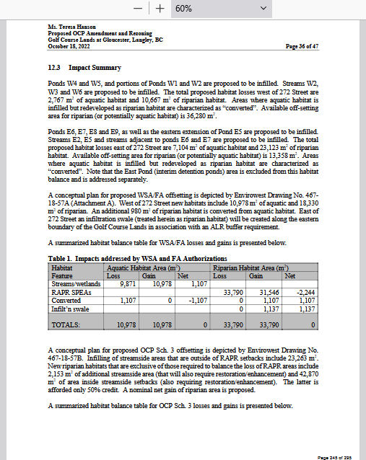
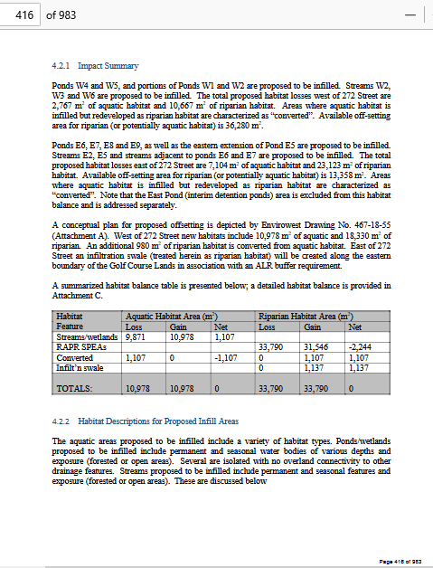
Oct 2022 Nov 2023

Slide 20
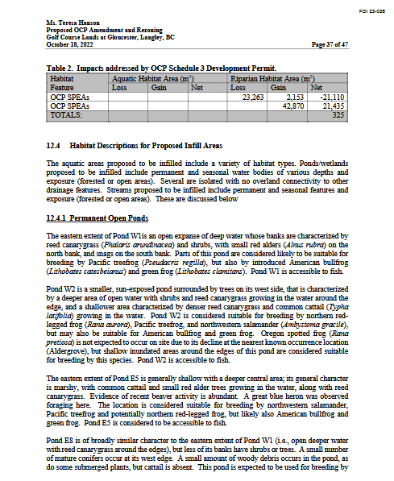

Slide 21
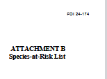
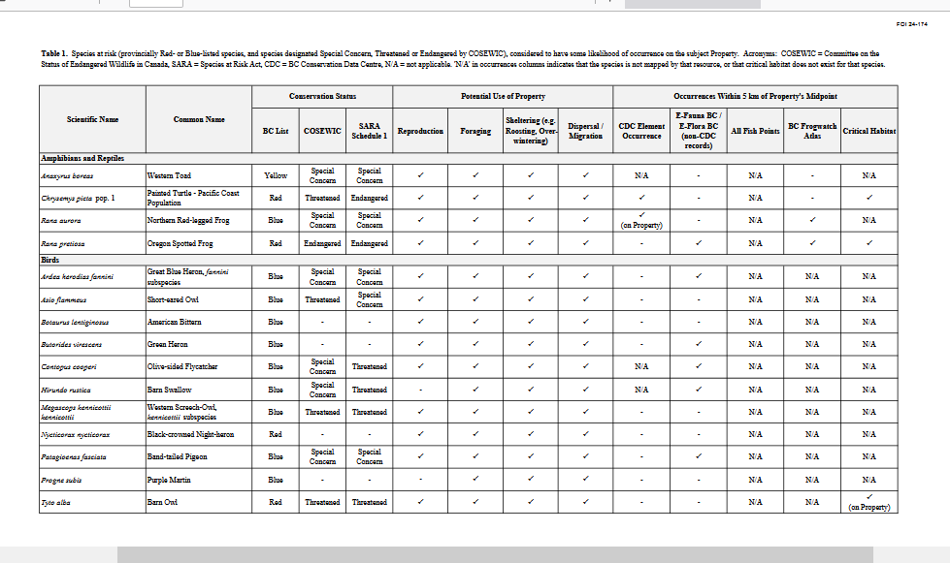
Page 448 to 450

Slide 22
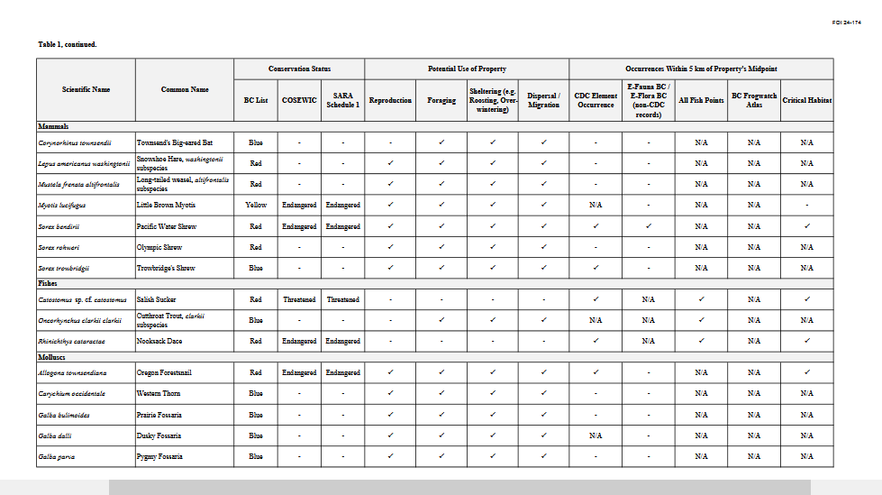

Slide 23
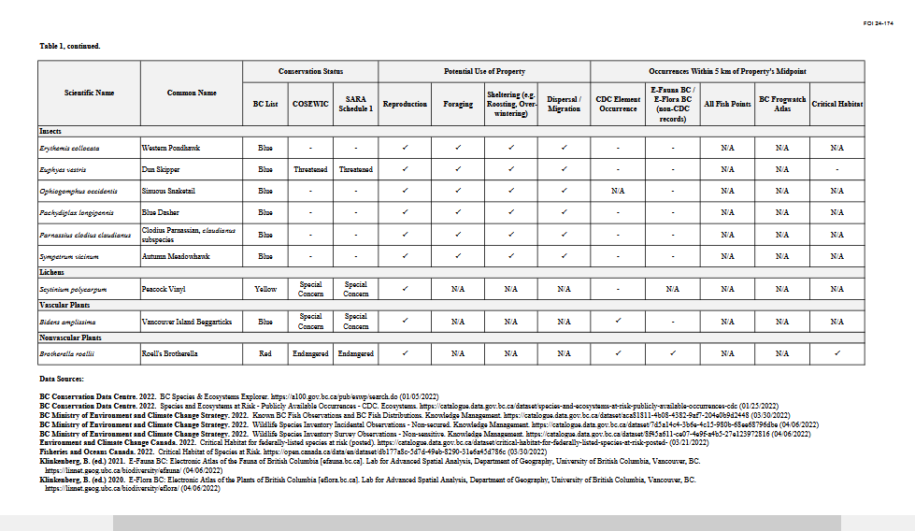

Slide 24
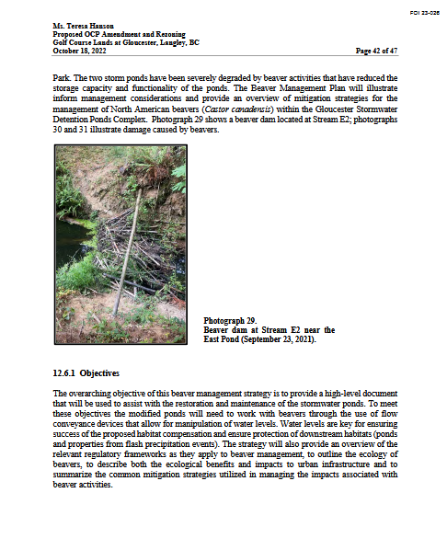
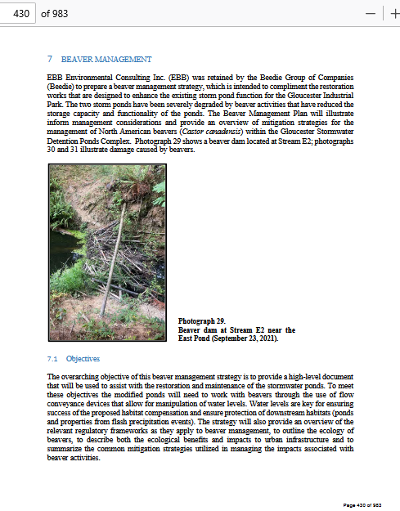
Oct 2022 Nov 2023

Slide 25
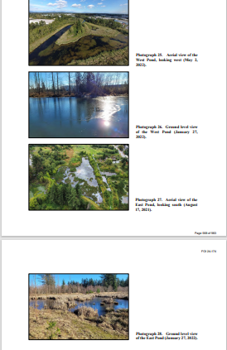
Pages
568
569
township-of-langley-foi-24-174.pdf

Slide 26
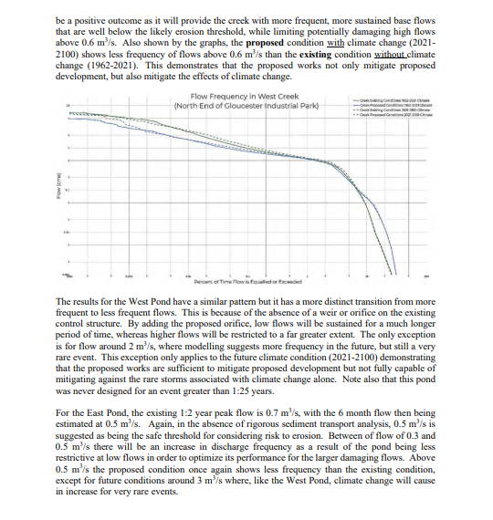
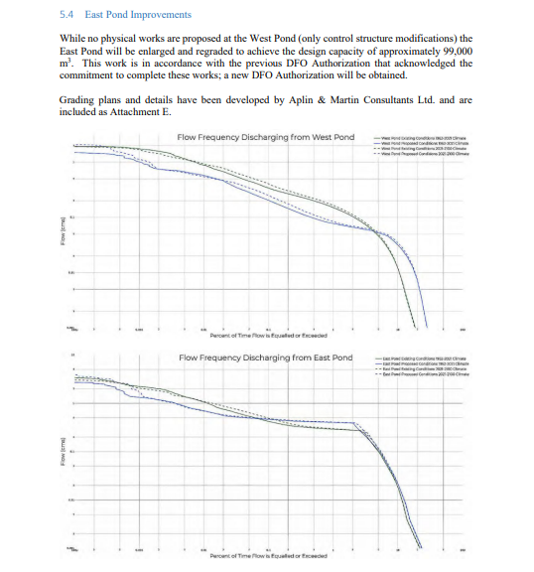
Pages
571
572

Slide 27
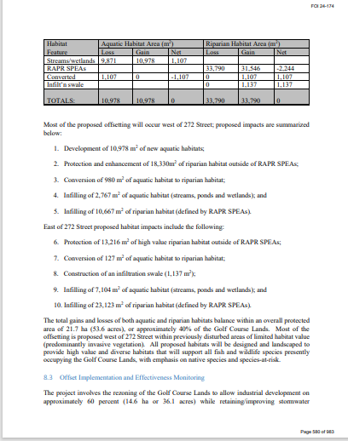
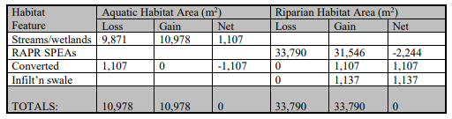
Page 580

Slide 28
The East Pond, as it currently exists, was intended only as an interim pond. This pond is to be expanded and a new control structure built to service six of the new lots. Analysis shows that peak flows in West Creek downstream of the development will improve significantly over current conditions and meet the original criteria of the development. The maximum permissible flow in West Creek immediately north of the Gloucester Industrial Park based on its original approval was 2.58 m3 /s for the 25 year event. Applying the same historic design event today, the peak flow in the proposed condition would be 2.4 m 3 /s, thereby satisfying the original criteria for West Creek. Analysis also shows that peak flow in West Creek will be significantly reduced from current levels when applying current design storms, thereby also meeting current criteria. And finally, continuous simulation shows that flow frequency above potentially damaging flows (using the 6 month, 24 hour event as the benchmark) will decrease with the proposed works, whereas the flow frequency below potentially damaging flows will increase. Both of these are positive outcomes for the health of West Creek
Page
615

Slide 29
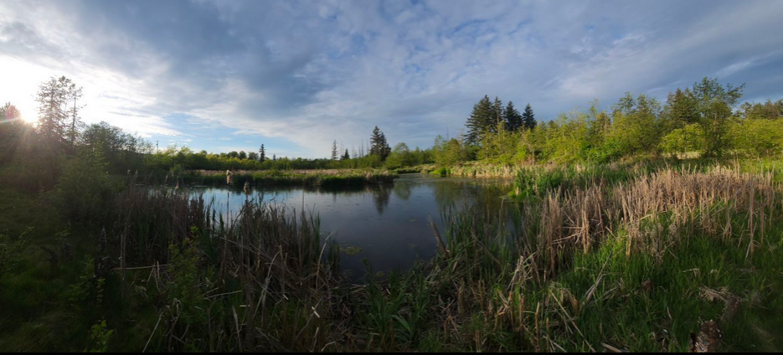
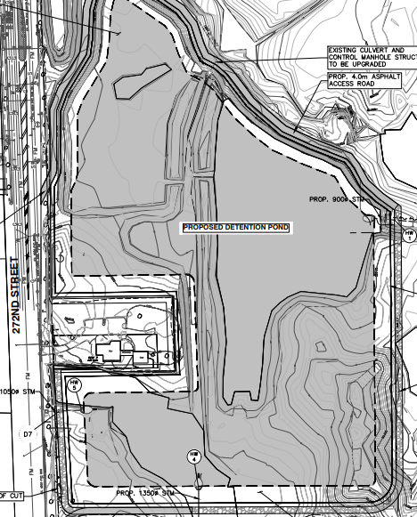
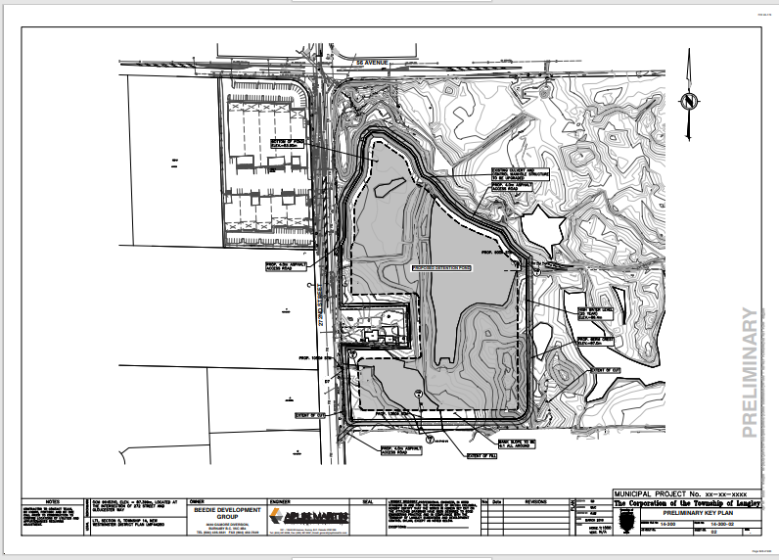
Page
628
https://www.youtube.com/watch?v=A6xie0URhcA

